Slide 1





Sensitivity Labels
“Notes from the Field”
Mathias Persoons
Toni Vervloet
26/6/2023
@Ordina

Slide 2




Mathias
TONI

Slide 3

Questions
Who has heard about Labeling?
Who is using them?
Who has implemented them?

Slide 4


Protecting Your Crown Jewels Data Visibility and Control
Do you know where your business critical and sensitive data resides and what is being done with it? (“Crown Jewels”)
Do you have control of this data as it travels inside and outside of your organization?
Are you using (multiple) solutions to classify, label, and protect this data?

Slide 5

The risks of dark data
15% Critical Data, visible, structured
20% Redundant, Obsolete and Trivial
65% Dark Data

Slide 6

The risks of dark data
Loss of trust
Do customers still want to work with you if you lose their trust?
Compliance as a basic requirement to do business.
Loss of intellectual property
What if your company jewels are lost or stolen?
Unintended oversharing or malicious intent, is it happening in your organization?
Reputational damage
Do you want to be the organization in the news?
How would you like to be remembered?
Fines
Can be significant and are real.

Slide 7
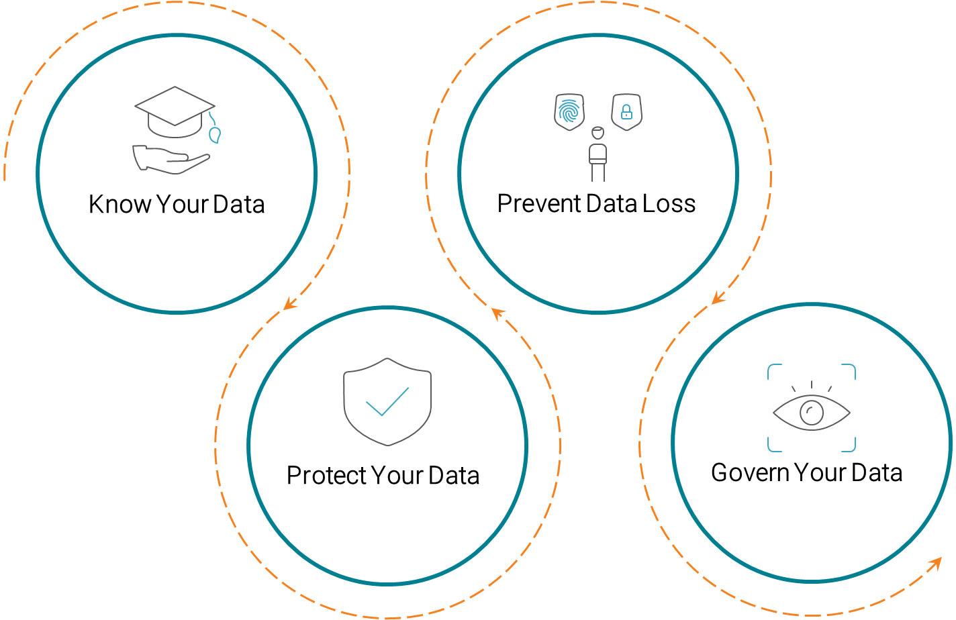
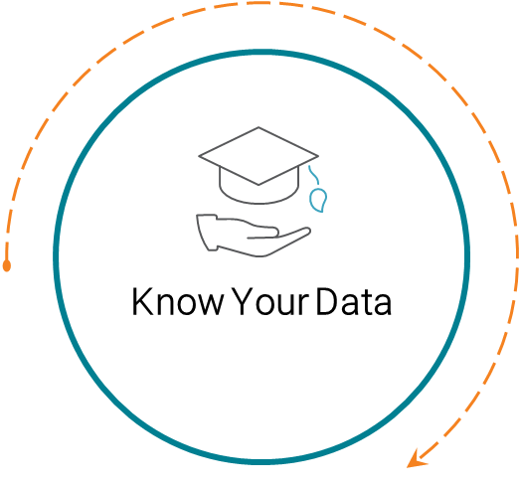
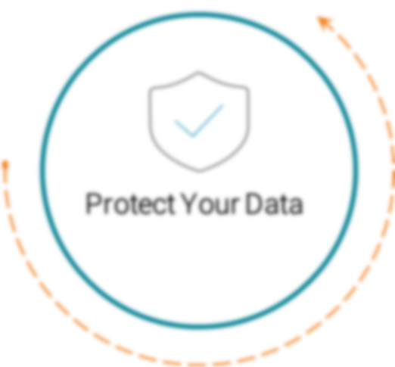
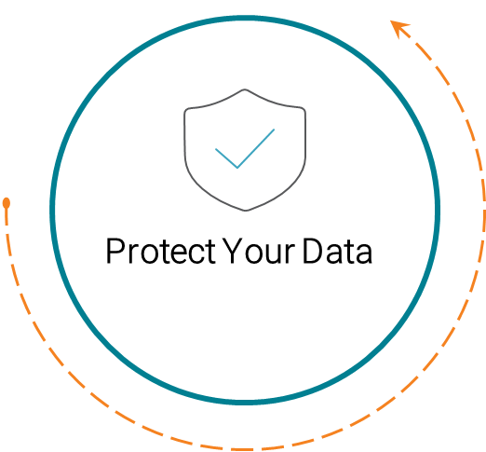
Information Protection & Governance

Slide 8
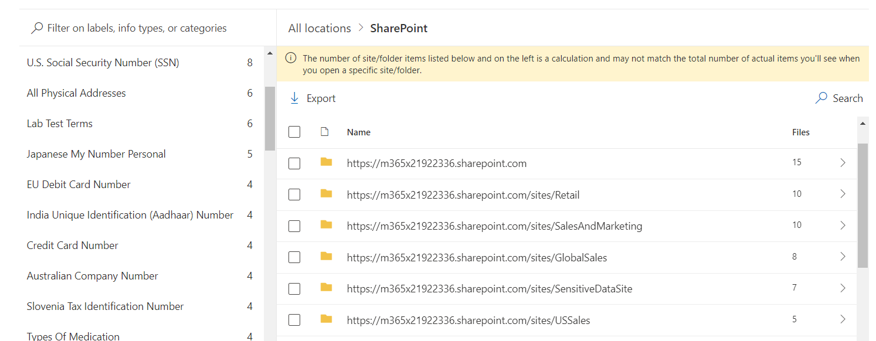
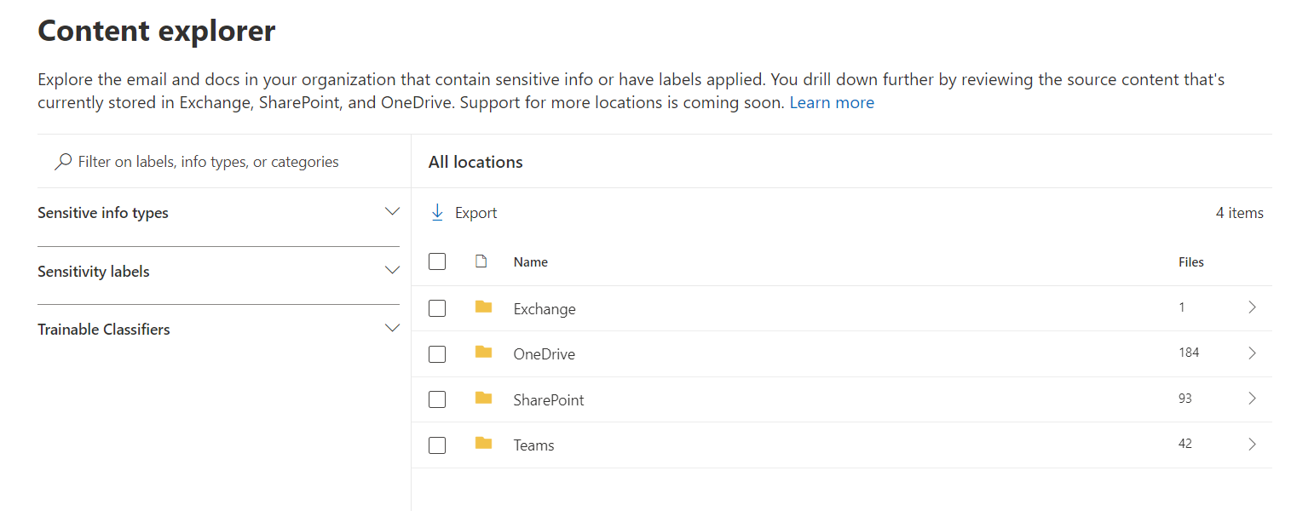
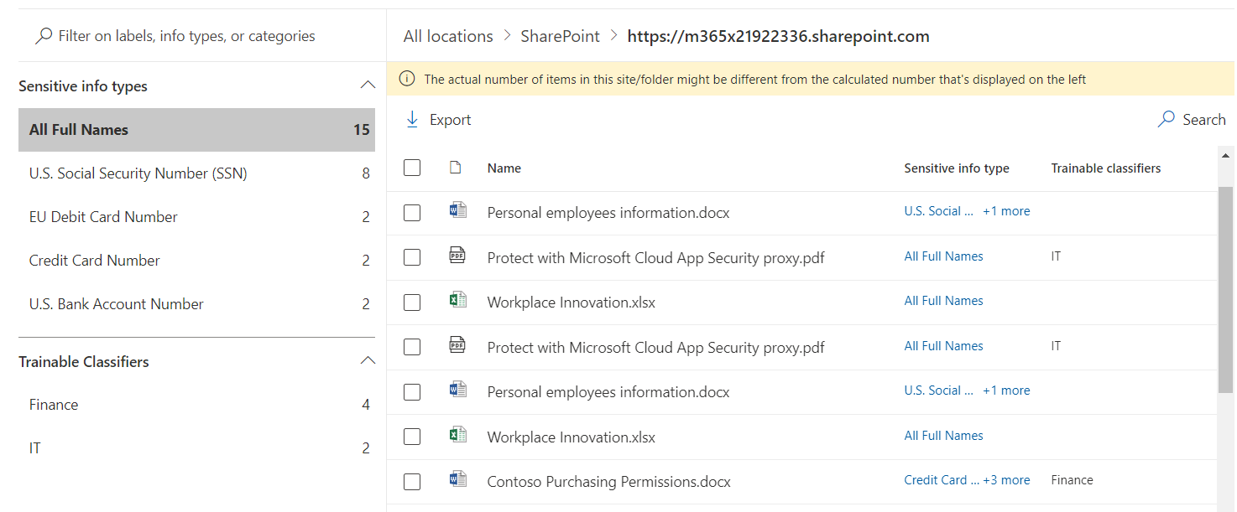
Content Explorer

Slide 9

Sensitive Information Type
Pattern based classifiers
Primary element
Supporting Element(s)
Proximity
Confidence levels defines how much supporting evidence is detected in proximity
Preconfigured by Microsoft or custom made

Slide 10
Sensitive Information Type Example
Identificatienummer van het
Rijksregister
75.05.12-978.54
Plaats van afgifte
Mechelen
Supporting element
Primary element
Proximity
Supporting element

Slide 11
Sensitive Information Type Example
How does this look in purview?
Identificatienummer van het
Rijksregister
75.05.12-978.54
Plaats van afgifte
Mechelen
Supporting element
Primary element
Proximity
Supporting element

Slide 12
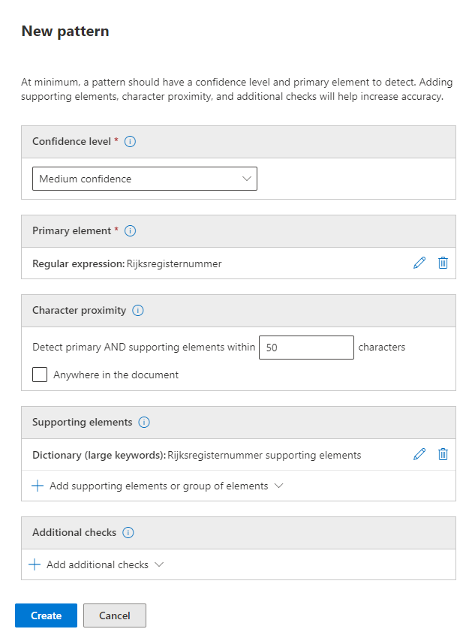

Slide 13
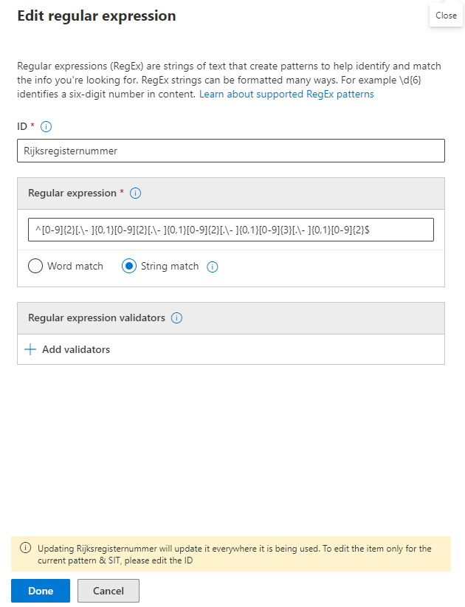

Slide 14
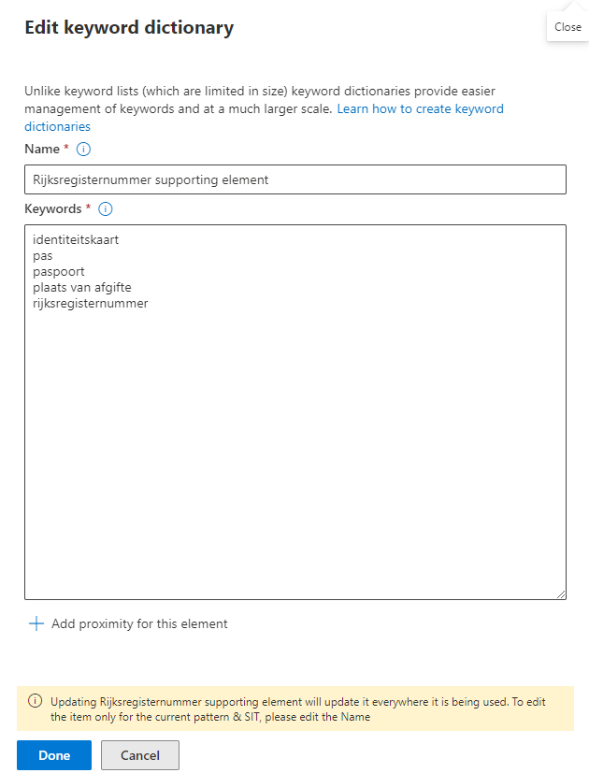

Slide 15

What is a sensitivity label
Purview
It’s like a stamp
Custom to your needs or organization
Stored as clear text
Persistent
Assigned to users via a Label Policy
Users see it as a tag on the email or file

Slide 16
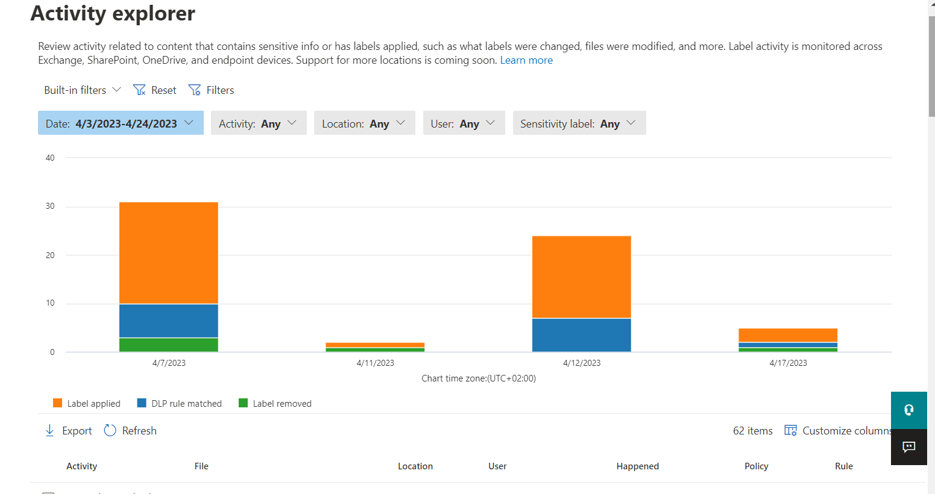
Activity explorer
Review activity related to content that contains sensitive info or has labels applied

Slide 17
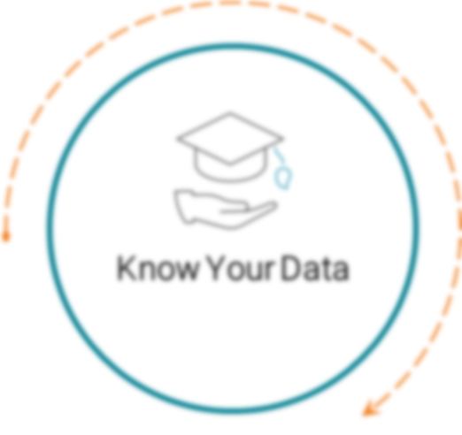
Information Protection & Governance

Slide 18

What can they do?
Mark the content
Header
Footer
Watermark
Encrypt your data
Emails, meeting invites, and documents
Automatic or suggested labeling
Client-side (part of label) vs service-side (policy)
Protect content in containers
Teams, MS365 groups or SPO Sites
Restrict access to your data (SharePoint & One Drive)
External sharing
Conditional Access settings

Slide 19

How are labels used?
Labels are added to a Label Policy and assigned to users
Usage is determined in the Label Policy
Optional or required labeling
Business Justification (remove or lower the label)
Default label: Yes or No
Inheritance from attachments
Custom Help page - refer to Customer Label Usage Policy
Label can/will change during the life cycle of the document

Slide 20

productivity vs. security
KIS(S) - principle (trying to stay polite)
Few top labels with (maybe) a couple of sub-labels
Confidential information may need to be shared with external parties.
Users may lower the classification of the document if it blocks them in their daily routine.
Custom protection options can be difficult for users and may result in sharing issues.
All actions can be monitored and logged. Also, important to review them on a regular basis. Certain patterns might need follow up

Slide 21
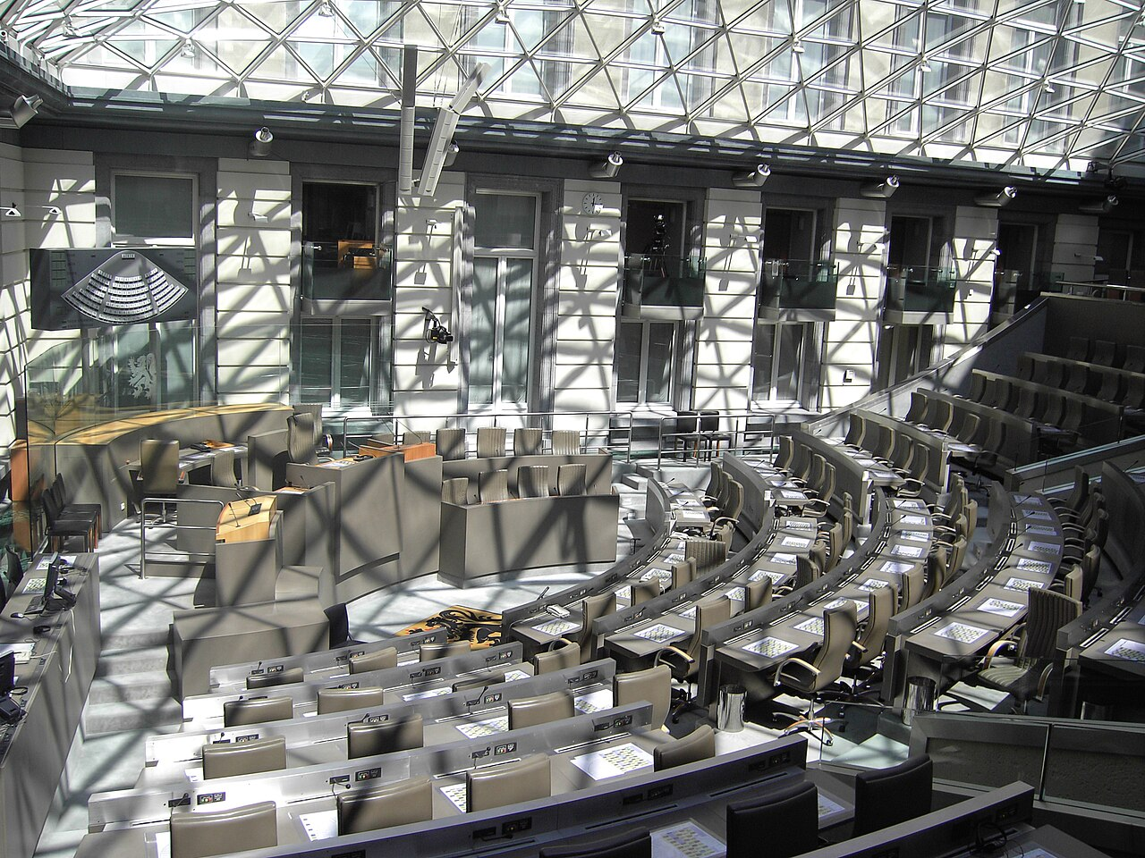
situation @ Customer
Migration of data to cloud (OneDrive/Teams/SharePoint)
In 2022, from file shares
Training /adoption story – up to 30h per employee (knowledge/exercise)
Analysis of data, define crown jewels (external exercise)
Existing data classification model, mostly on paper
Now that they are working on the cloud, they wanted to “quickly” implement some Information Security.
This Photo by Unknown Author is licensed under CC BY-SA

Slide 22
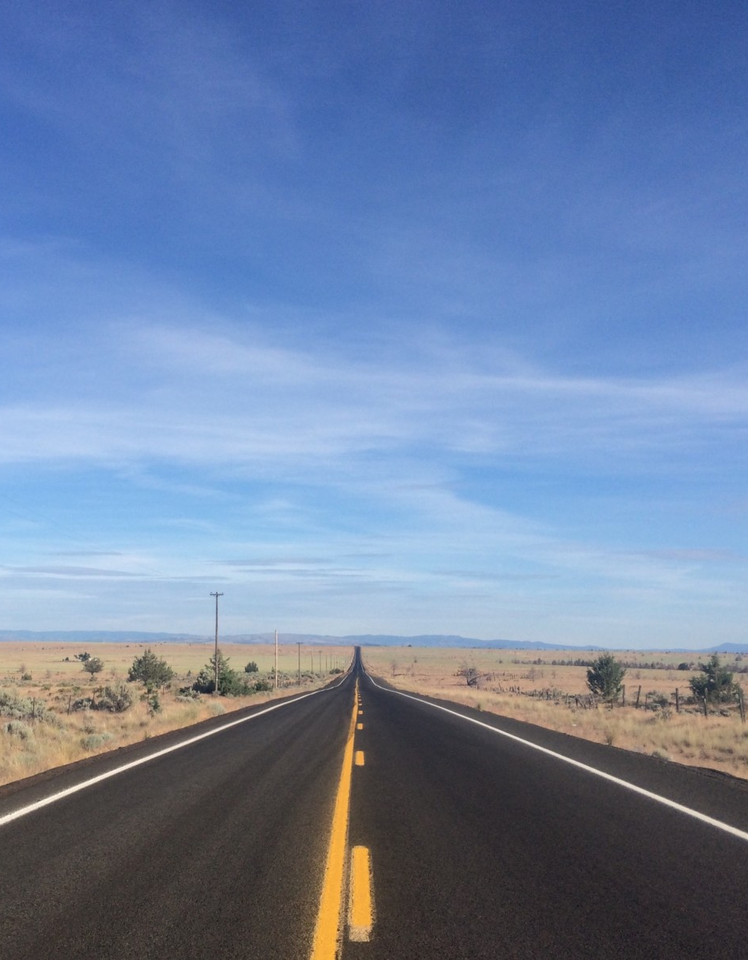
Approach
Kickoff workshop
Data discovery on their dev tenant
Real data
Content Explorer
Three workshops
Basic concepts & training
Define Labels and Policies
Set up customer specific use cases
Test plan for each phase
Executed by customer + review results & adapt
Activity Explorer to give insights & monitor
Lessons learned and next steps

Slide 23
Lessons Learned
Default label
Label inheritance
Super User
OME/AME vs Labels
Verify policy changes
Test on all platforms
Adoption is key
Auto-labeling: 2 flavors

Slide 24

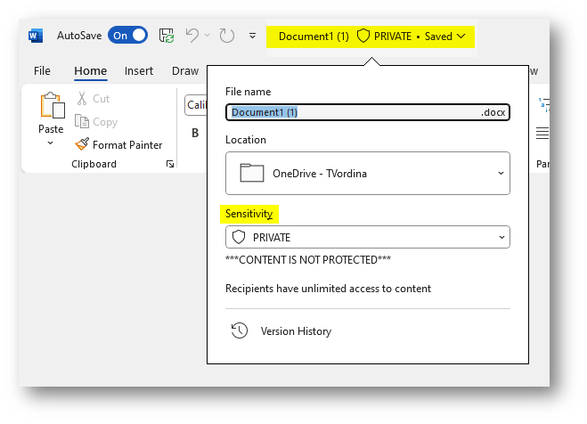
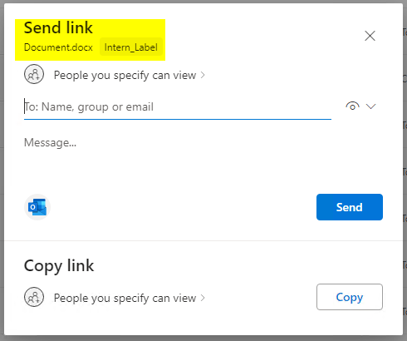
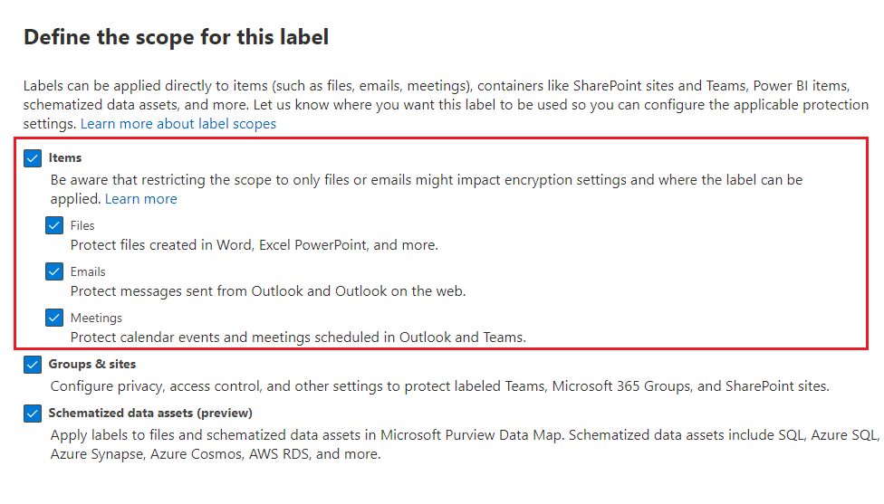
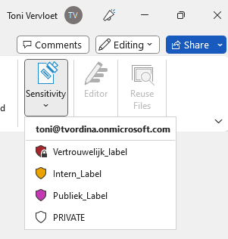
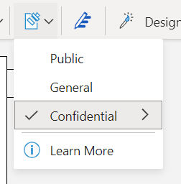
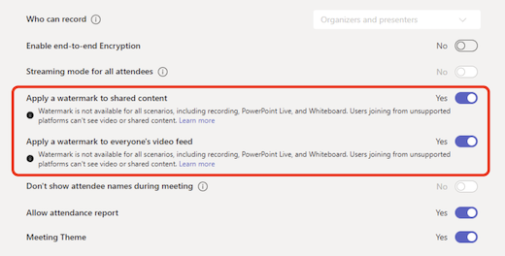
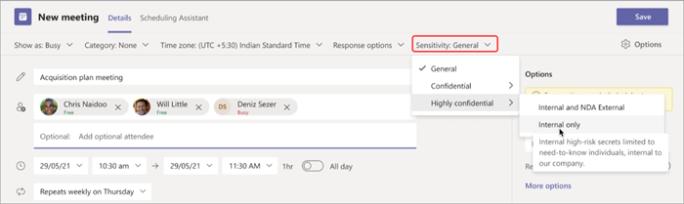
What’s new
Coloring scheme
Information Bar
Labels visible in SPO sharing dialog box
Encryption algorithm changes
Teams Premium – Meetings and Calendar Events
Split of Items (Files – Emails - Meetings)
AES128-ECB
AES256-CBC

Slide 25


